Slide 1

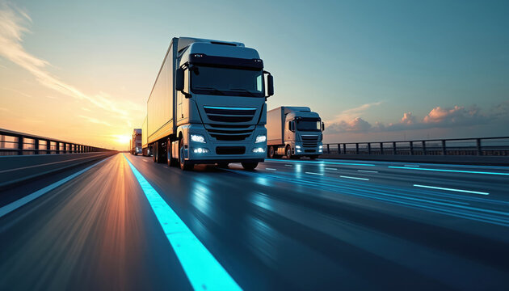
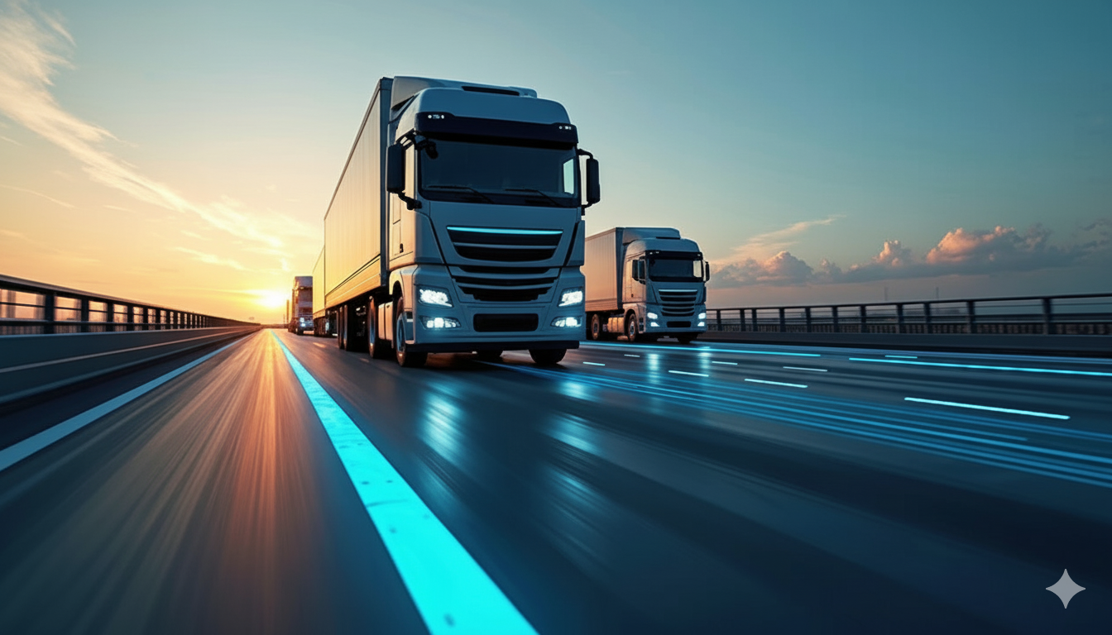



IOT FLEET MONITORING AND PREDICTIVE MAINTENANCE WITH SAGEMAKER

Slide 2
PROJECT OVERVIEW
This project focuses on tracking vehicle health and performance in real time using AWS services.Fleet monitoring is continuously observing vehicles (like trucks) to detect issues such as high temperature, faults, or abnormal behavior. Predictive maintenance helps identify problems before they occur, reducing breakdowns and improving safety.
In this system, vehicle temperature raw data is uploaded to S3, Lambda processes it, SageMaker predicts maintenance needs, DynamoDB stores results, and SNS sends instant alert emails to the driver/admin when critical issues are detected.

Slide 3
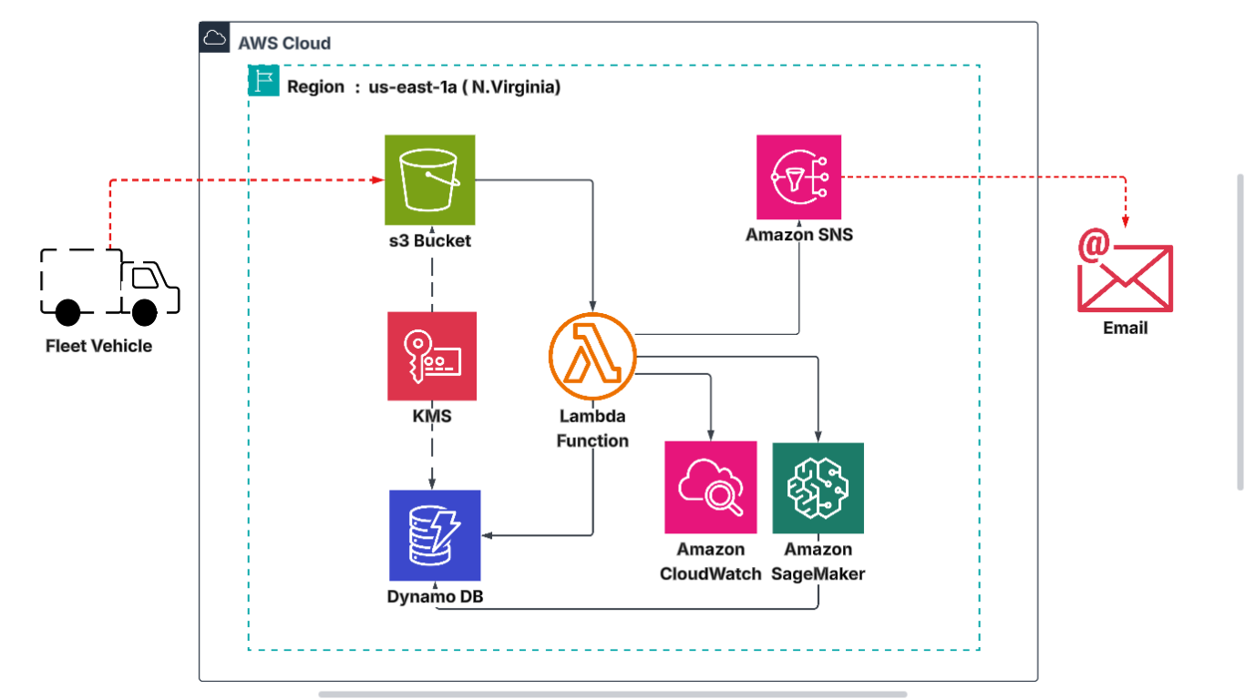
PROJECT OVERVIEW
ARCHITECTURE

Slide 4
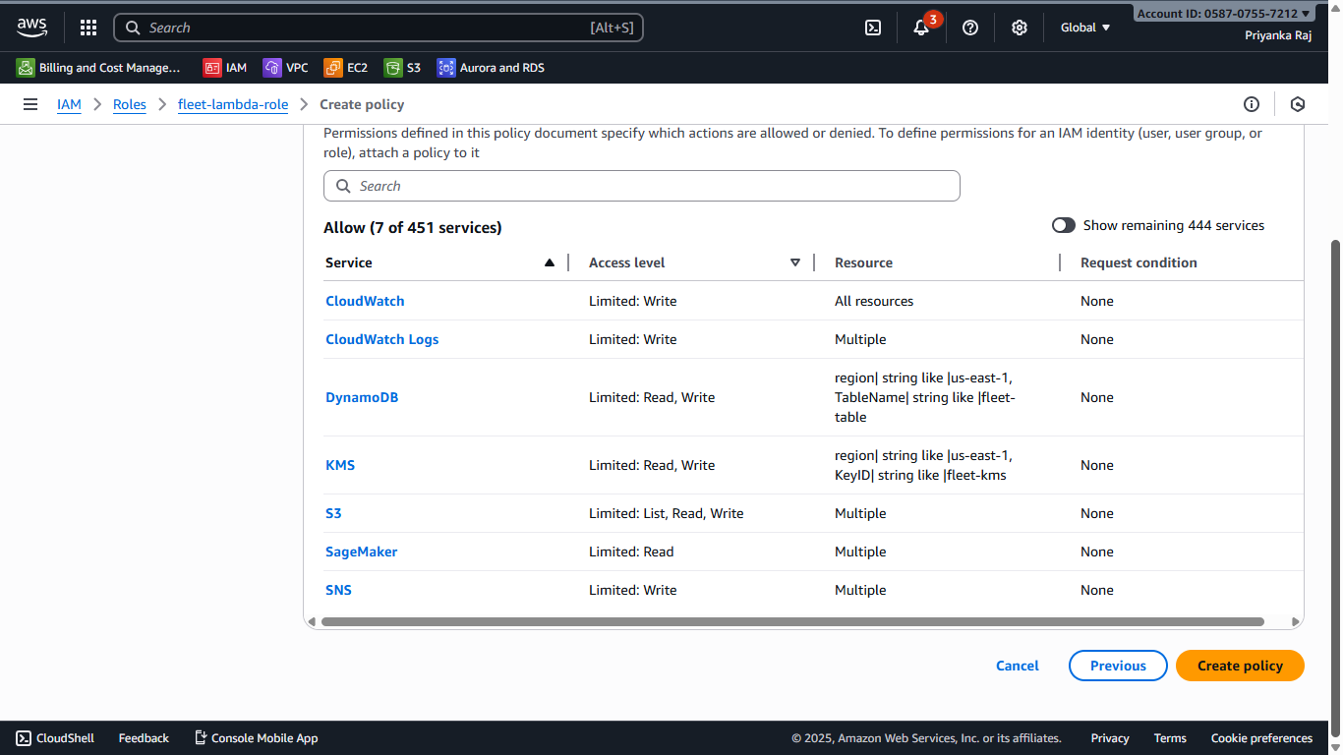
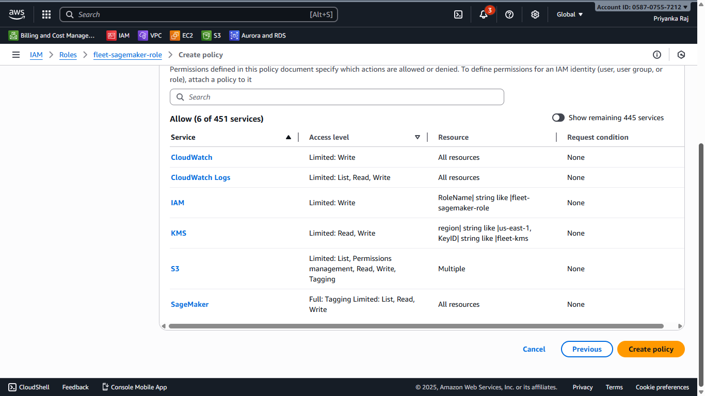
IAM ROLE
Creating IAM role for Lambda and Sagemaker with permissions for S3,Sagemaker,KMS,Dynamo DB,Cloudwatch and SNS.

Slide 5
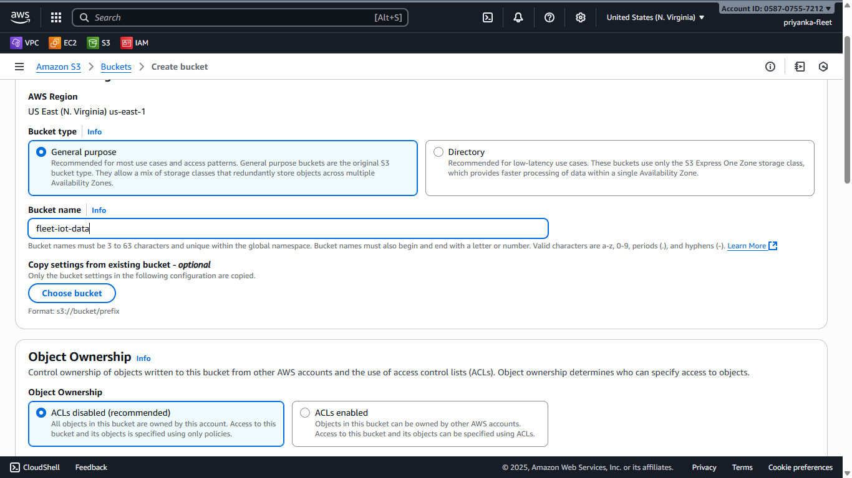
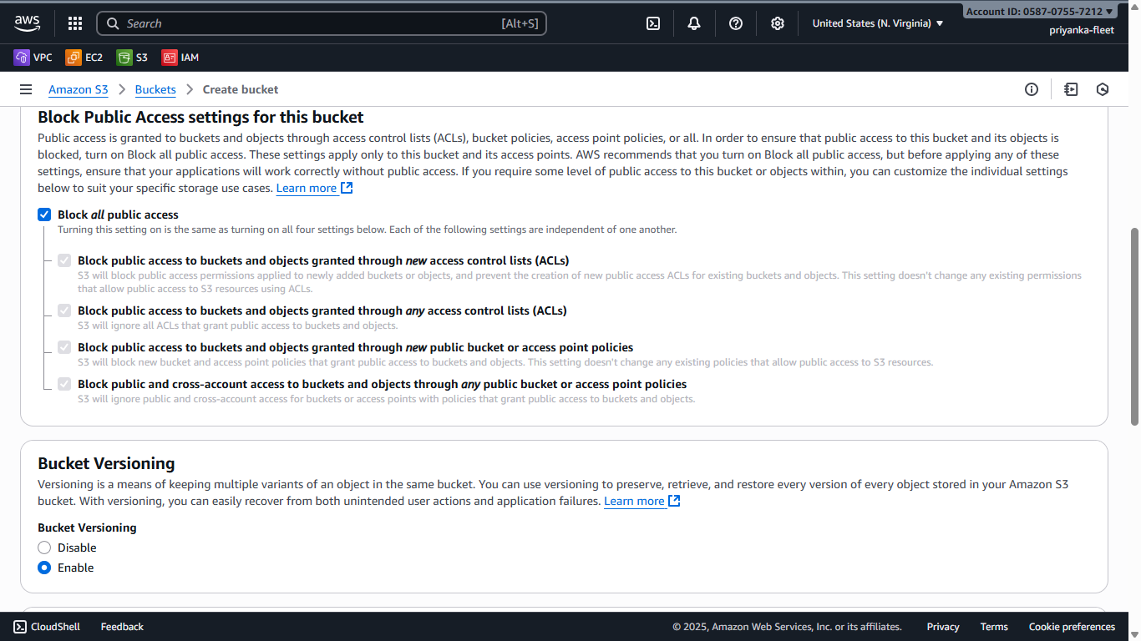
S3 BUCKET
Creating s3 bucket with ACLs disabled ,public access blocked and bucket versioning enabled

Slide 6
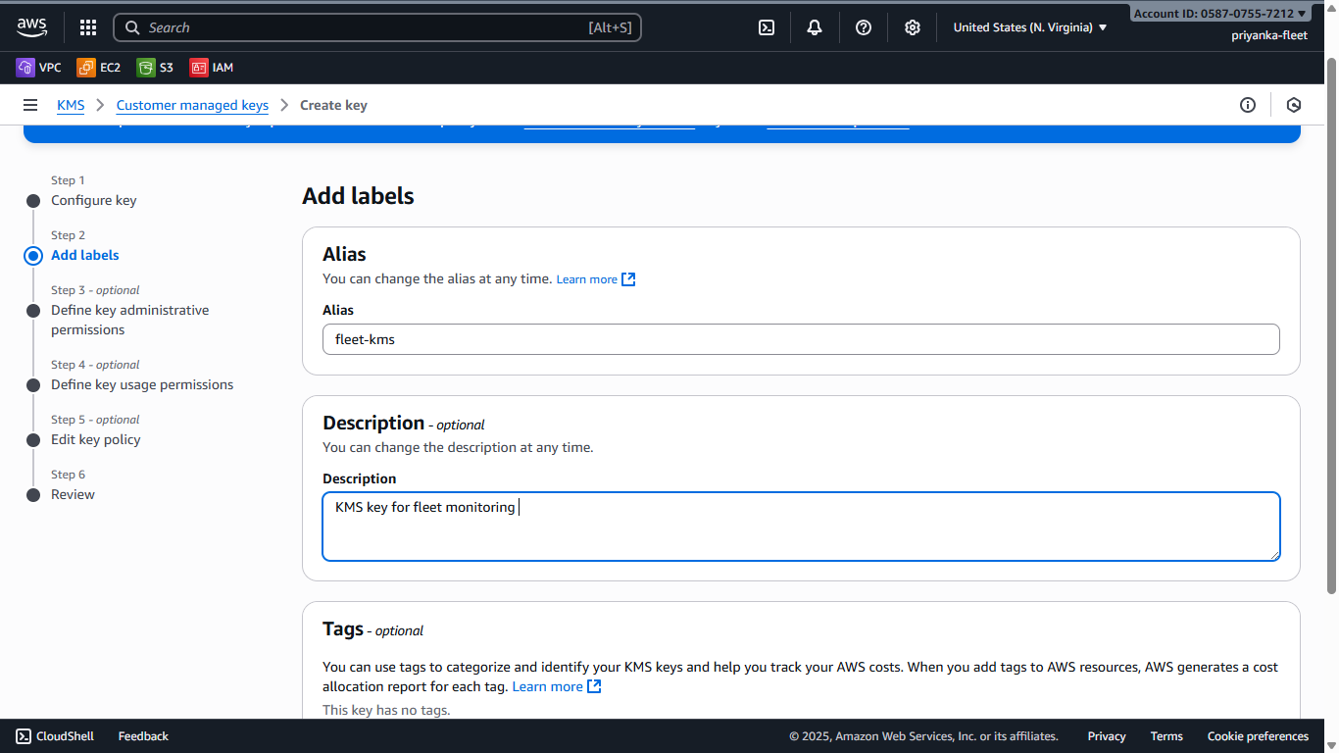
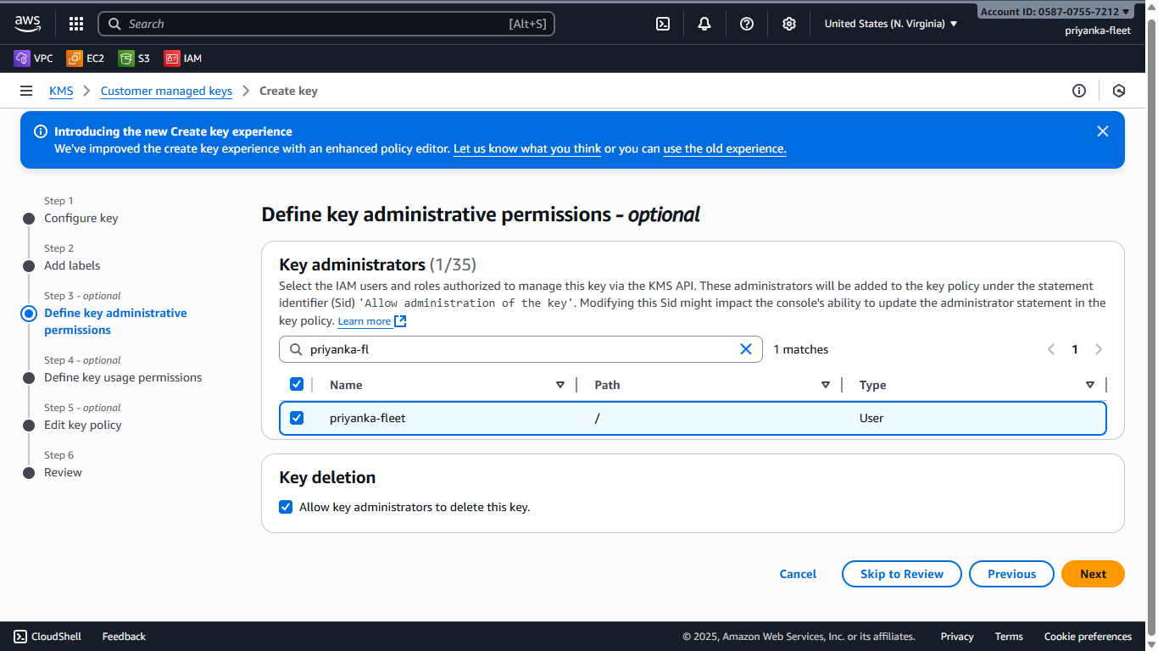
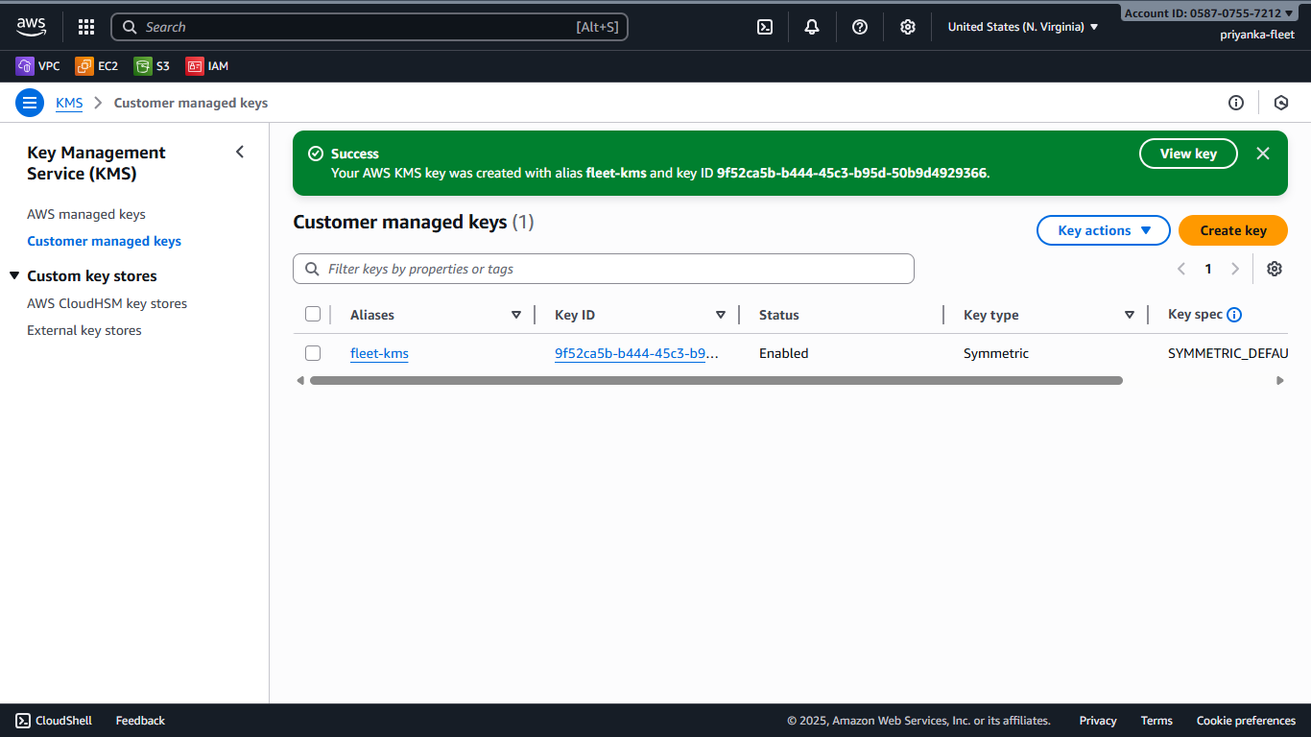
KEY MANAGEMENT SERVICE -KMS
Creating KMS key with permisions given to respective IAM user to encrypt and decrypt S3 and Dynamo DB.Permision given to respective IAM user ID

Slide 7
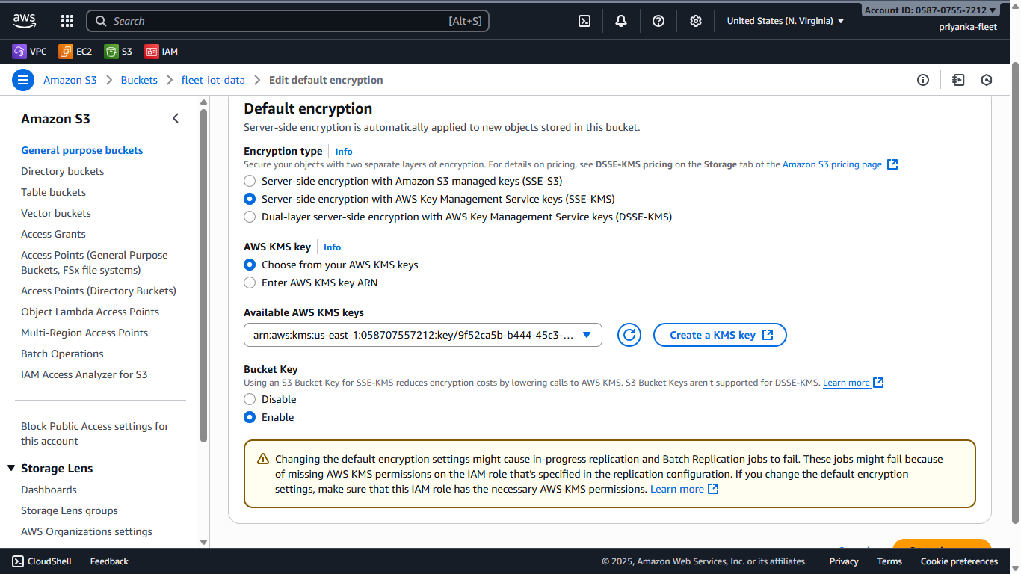
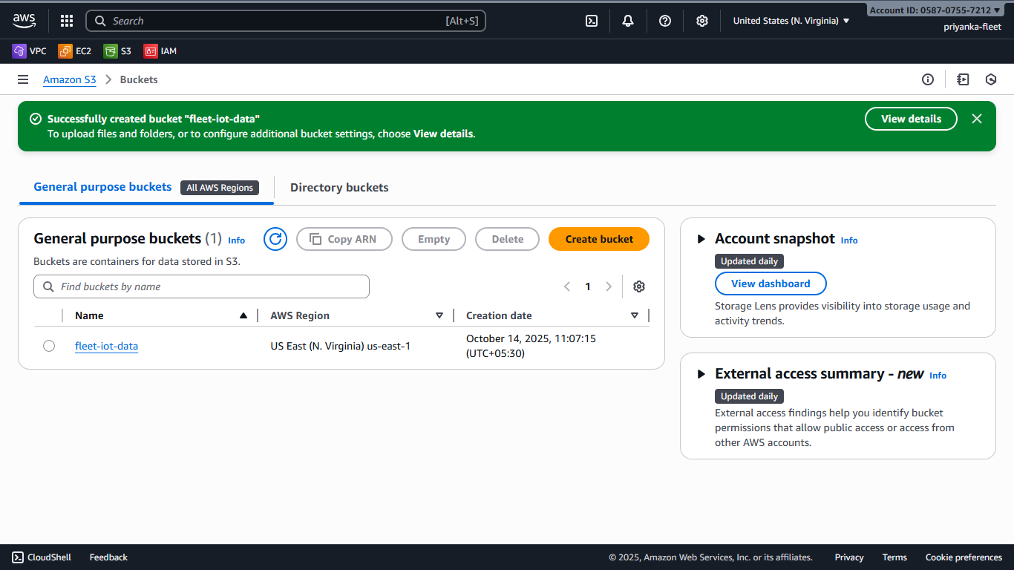
ATTACHING KMS KEY TO BUCKET
Attaching the KMS key to s3 bucket

Slide 8
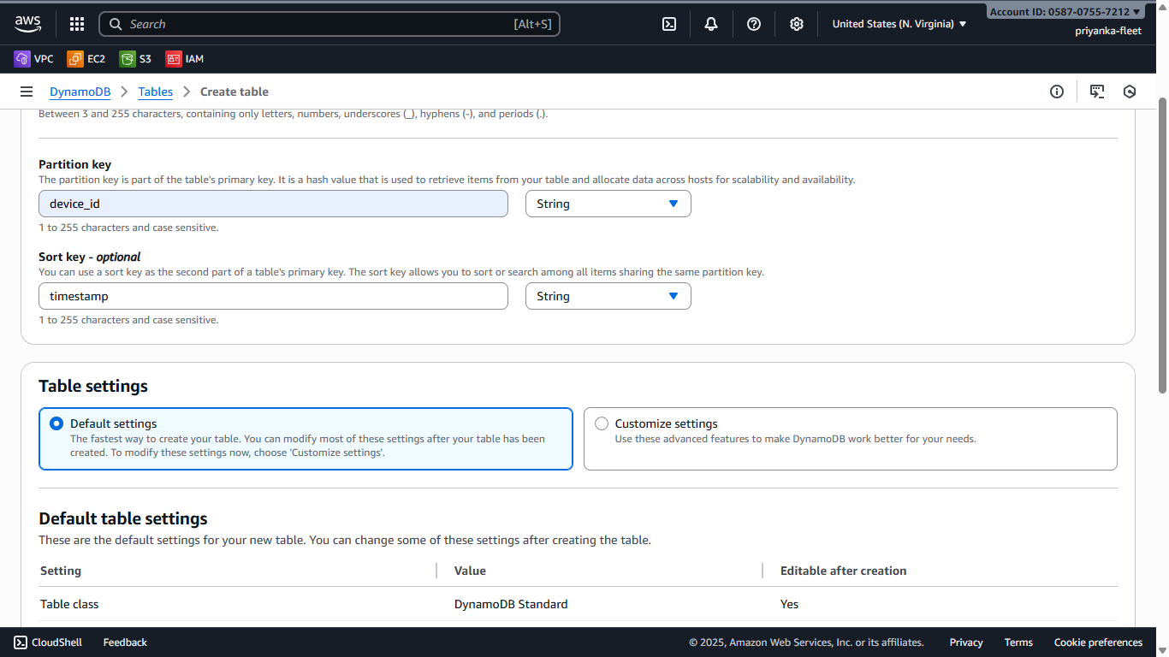
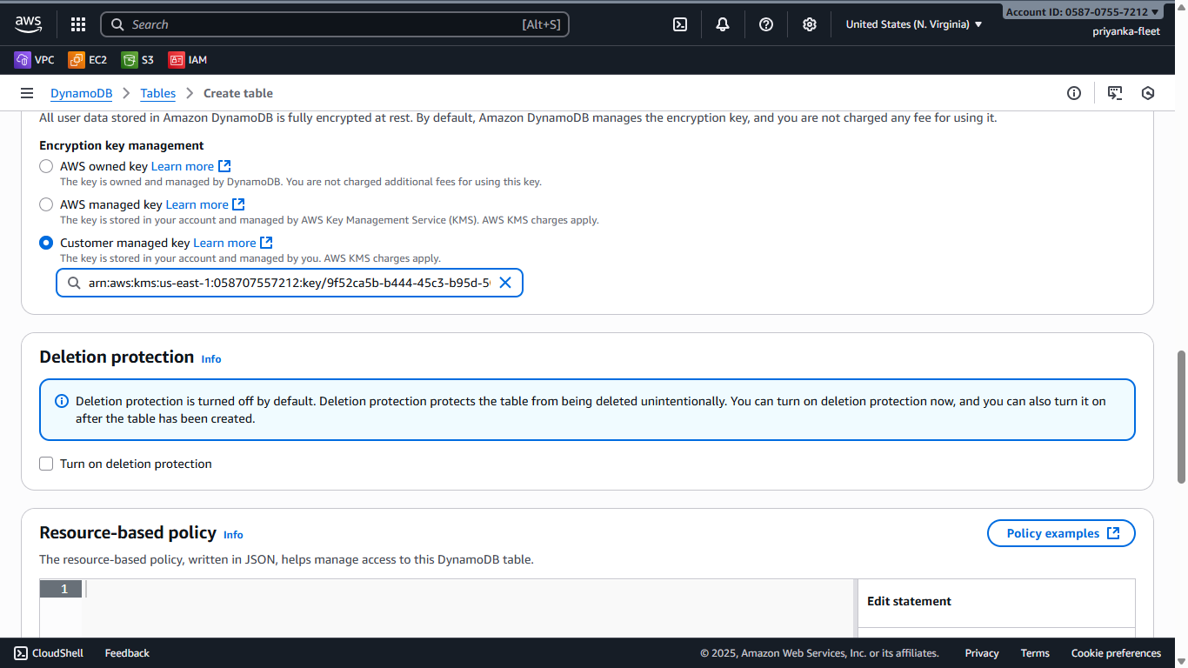
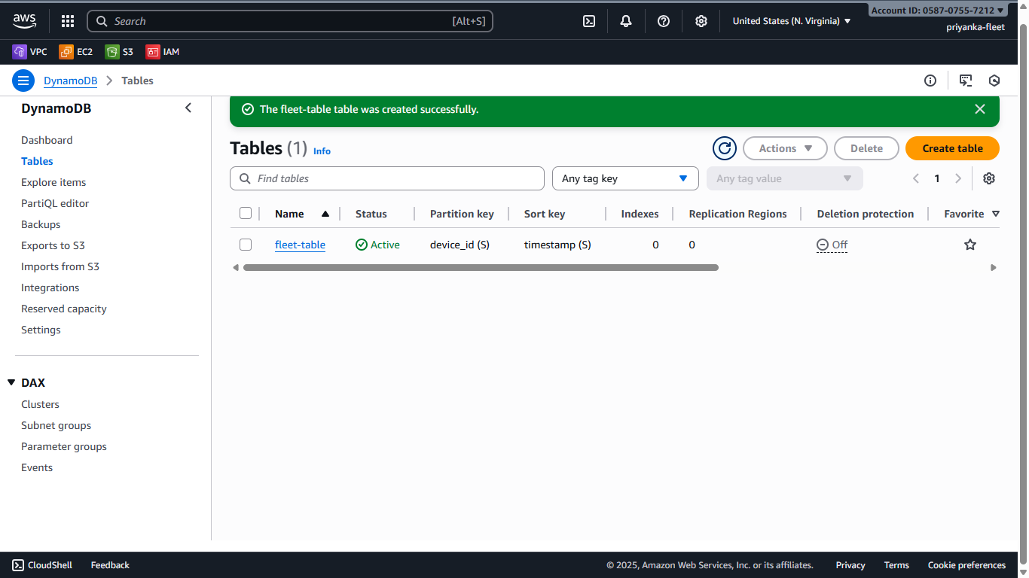
DYNAMODB TABLE
Created Dynamo DB table with the required partition key and Source key ,added the KMS key as well for encrytion and decryption.

Slide 9
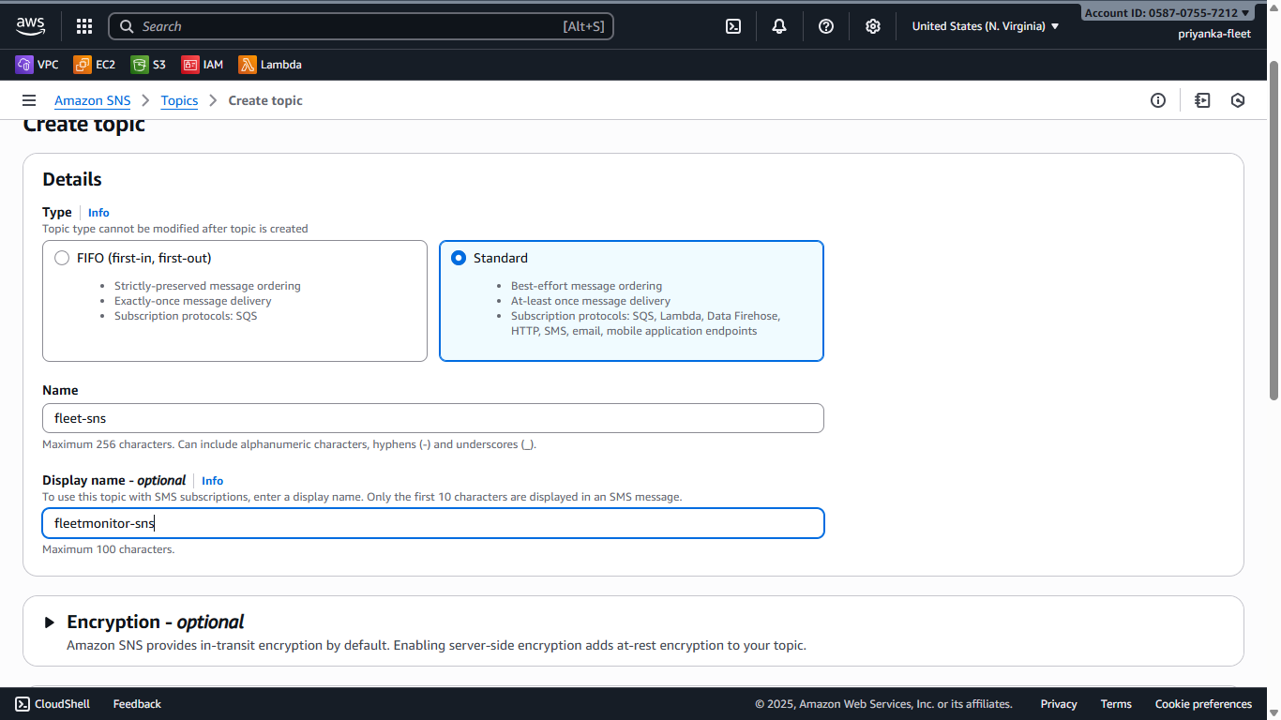
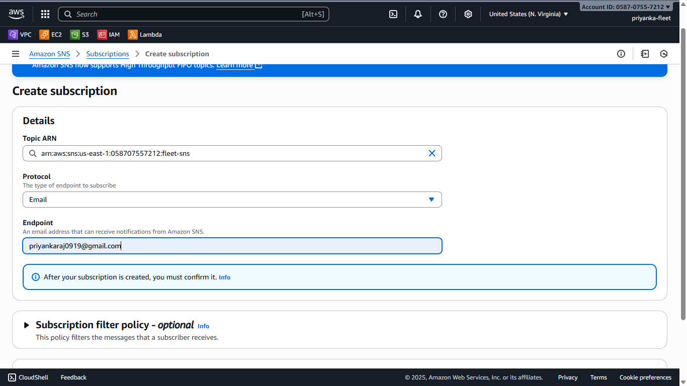


AMAZON SNS
Created SNS topic,added mail address under subscription to receive fleet alert mail

Slide 10
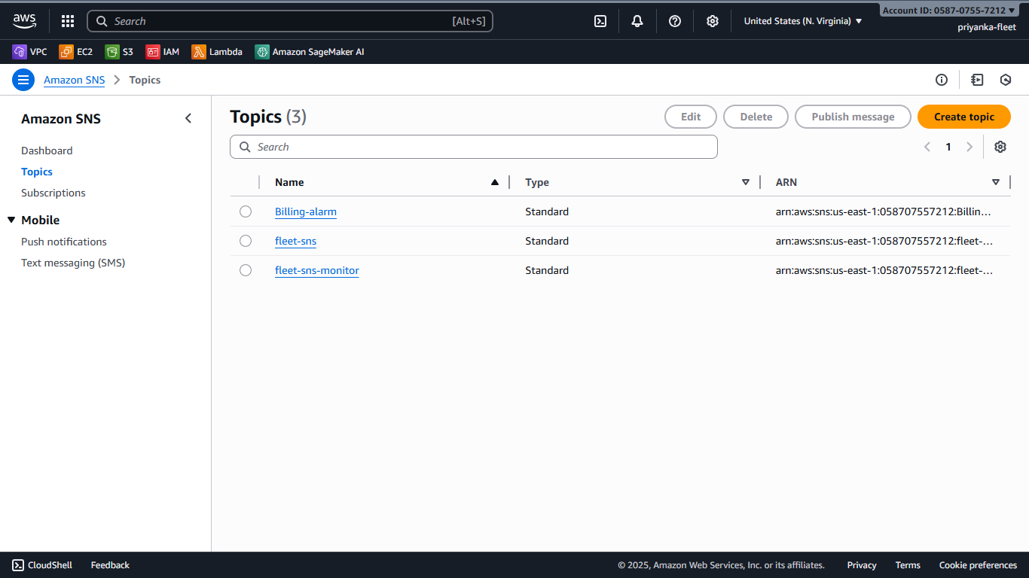
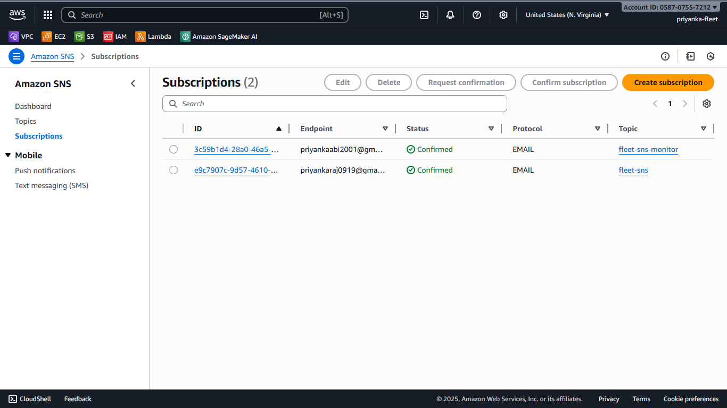
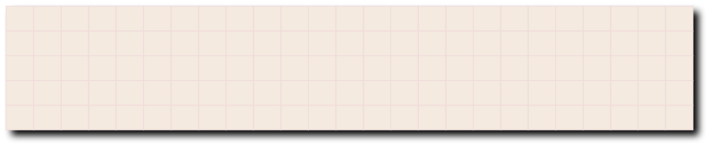
AMAZON SNS - TOPICS AND SUBSCRIPTIONS
Added 2 topics and 2 Subscription mail address to check the demo

Slide 11
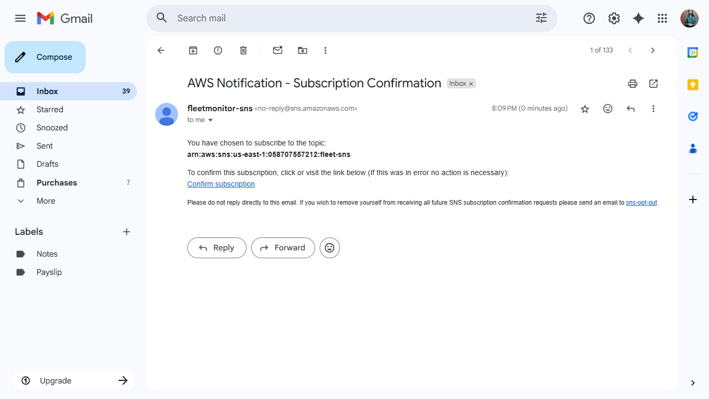
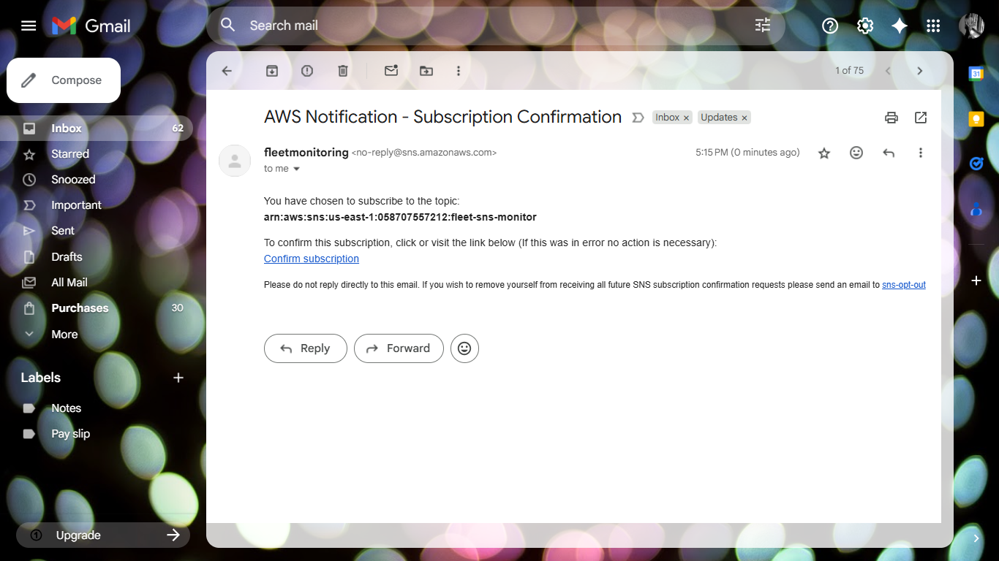
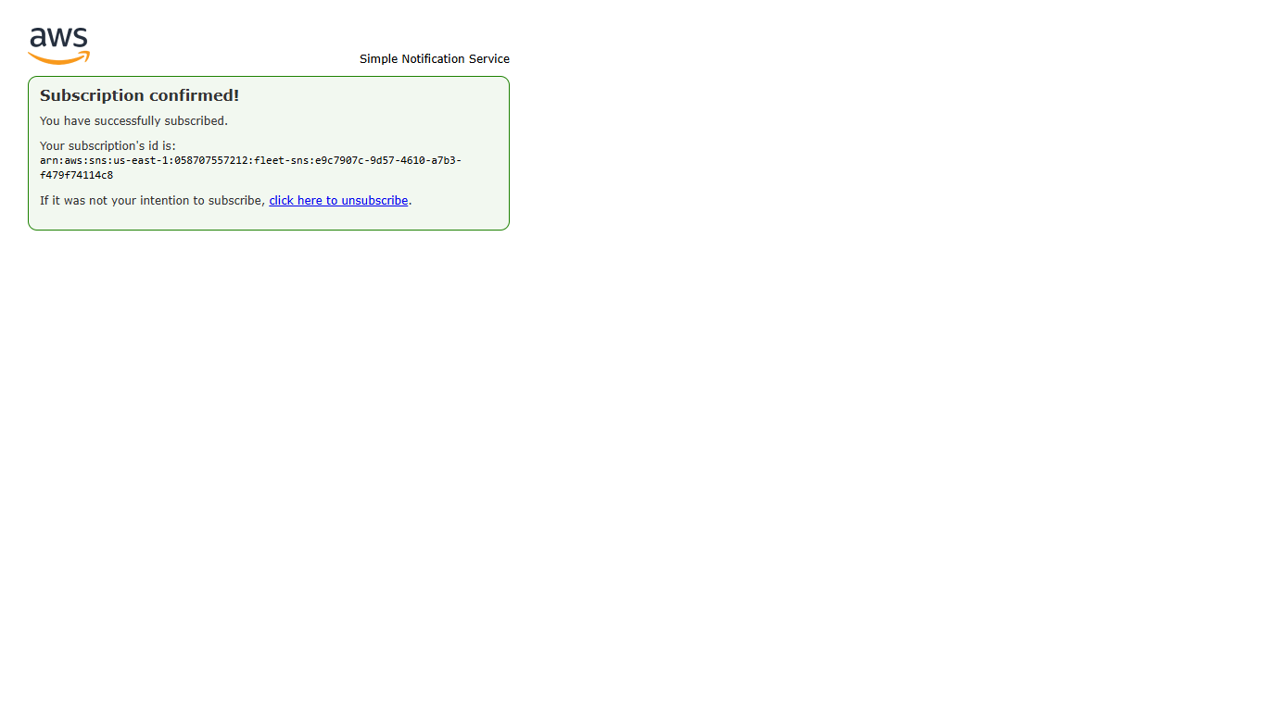
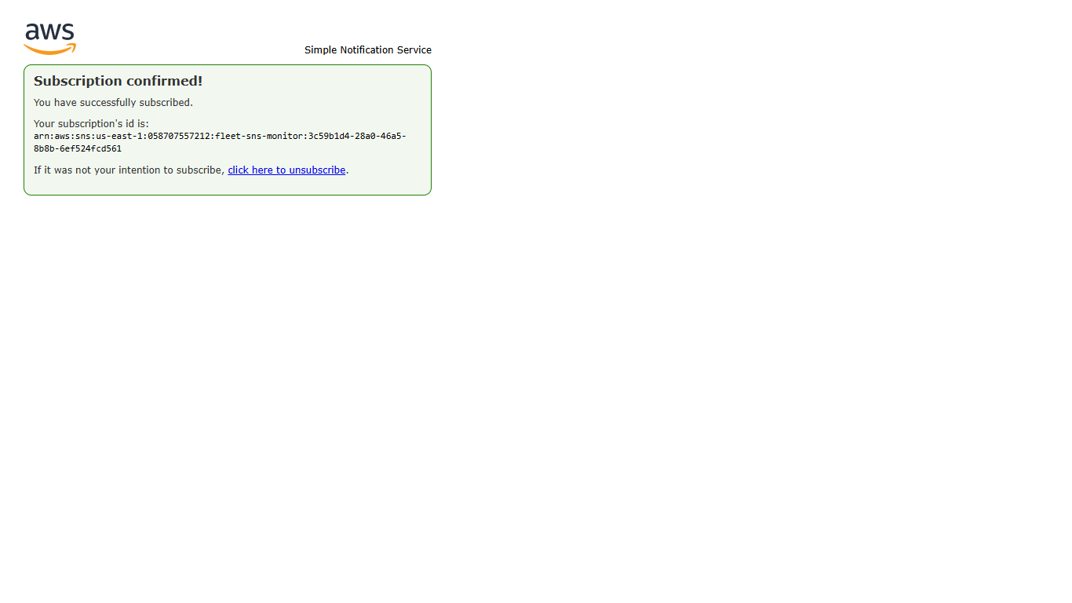
CONFIRMATION MAIL
An Automateded email for subscription is received,confirmed subscription to get the alert mails

Slide 12
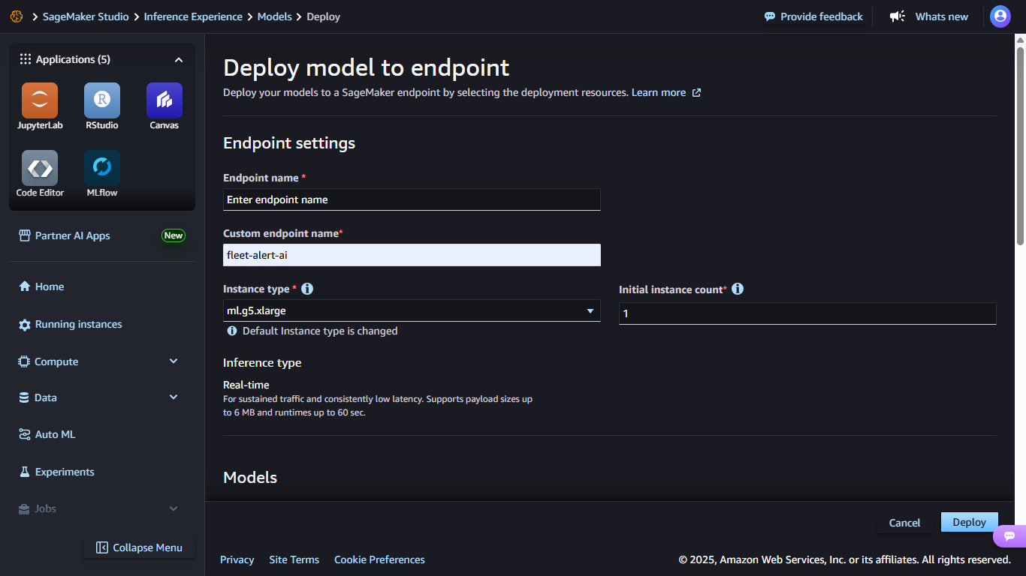
SAGEMAKER ENDPOINT
Creating Sagemaker endpoint to revoke it from Lambda using text classification model for prediction.

Slide 13
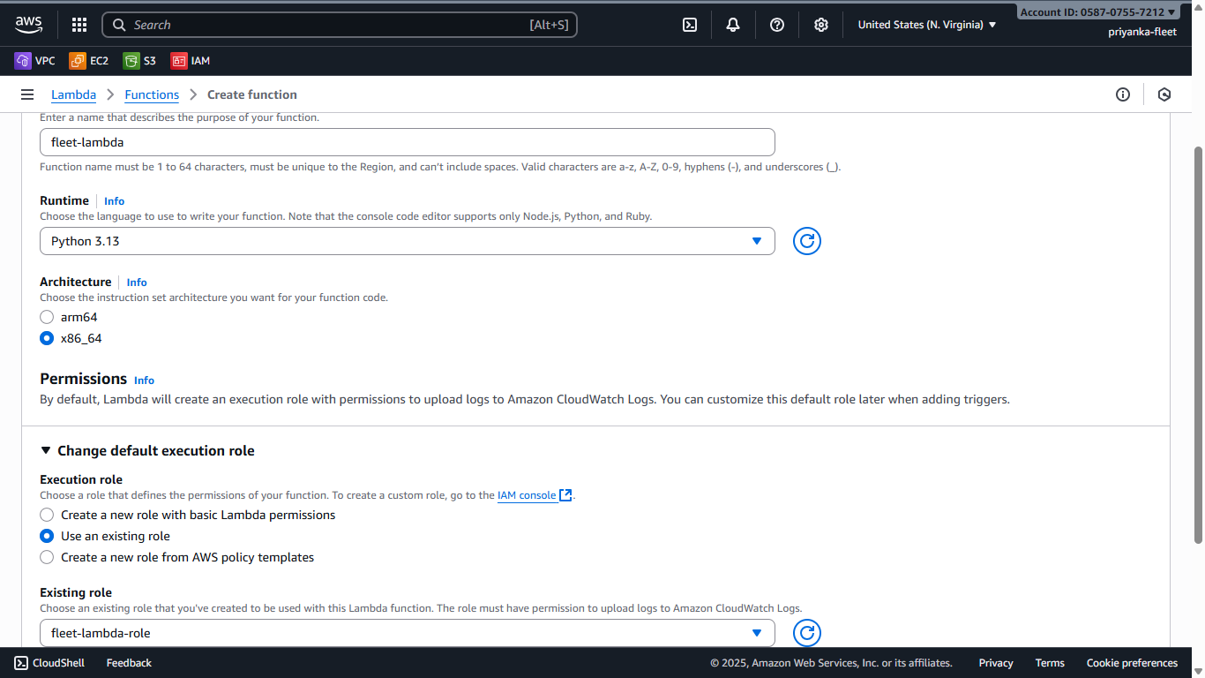
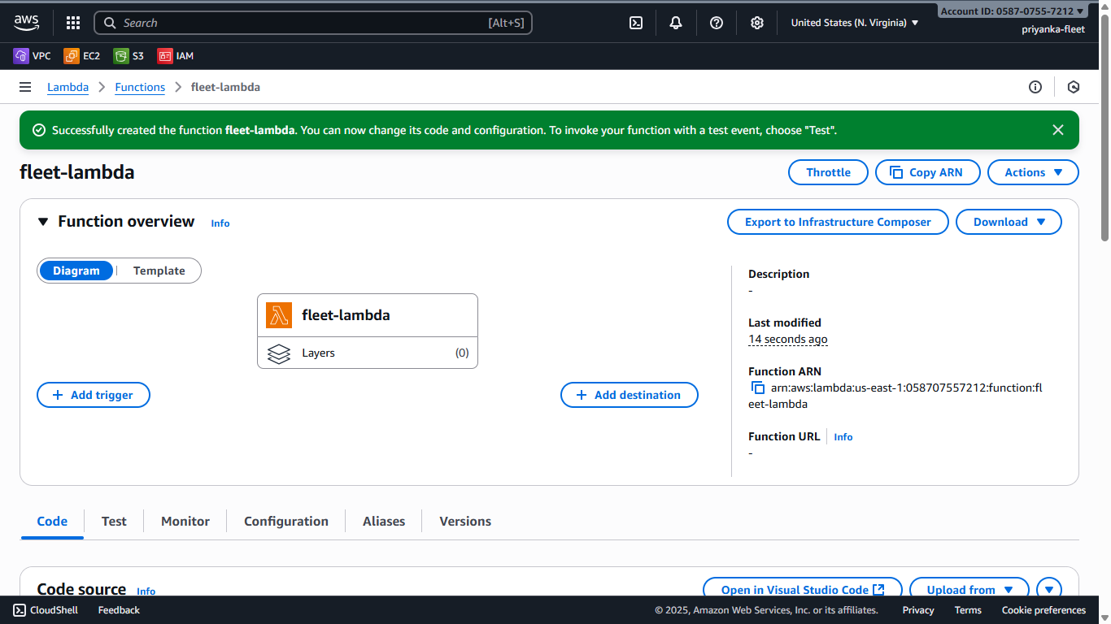
AWS LAMBDA
Created Lambda function with Runtime Python 3.13 and attached the respective role created.

Slide 14
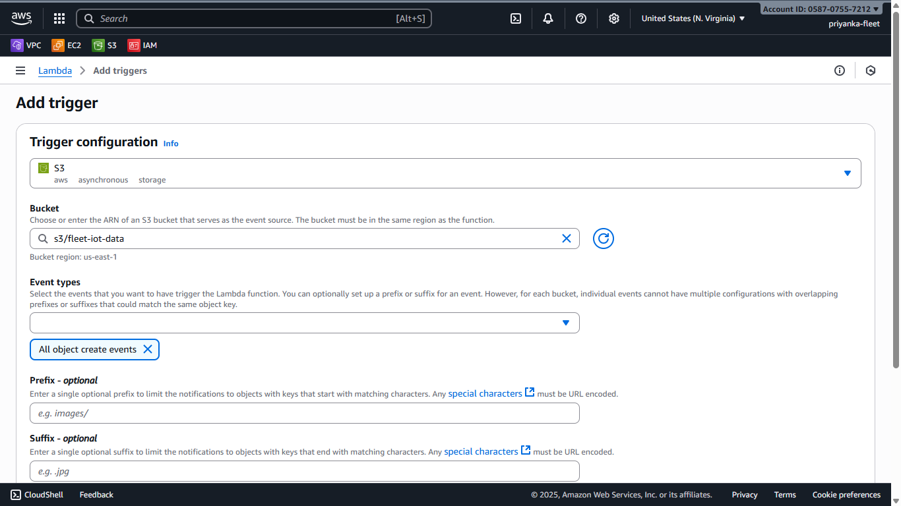
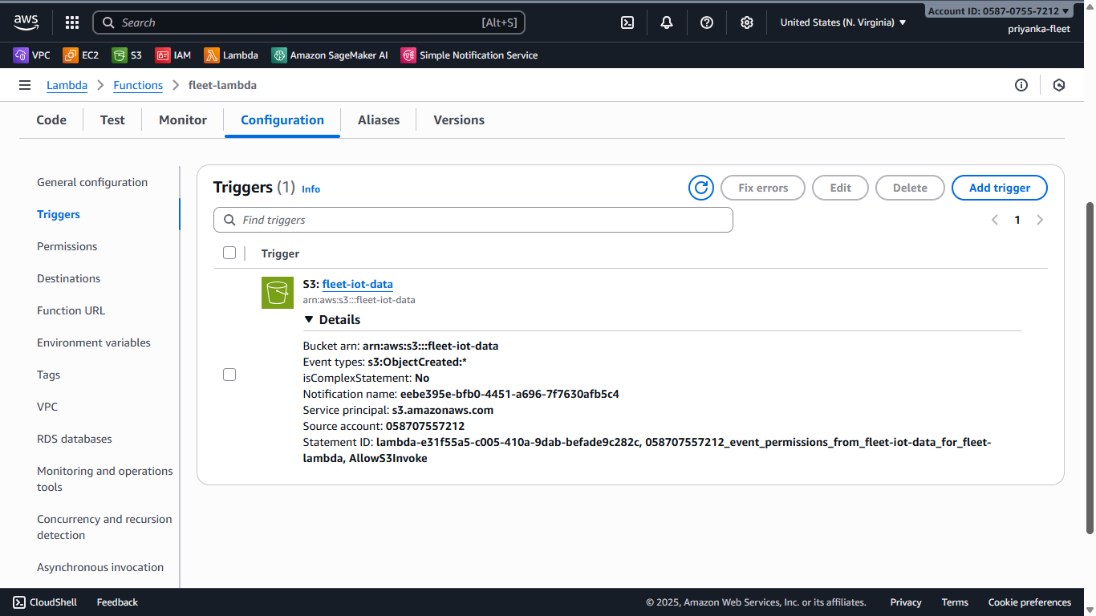
S3 TRIGGER FOR LAMBDA
Added S3 trigger to lambda,with the required event and permissions

Slide 15
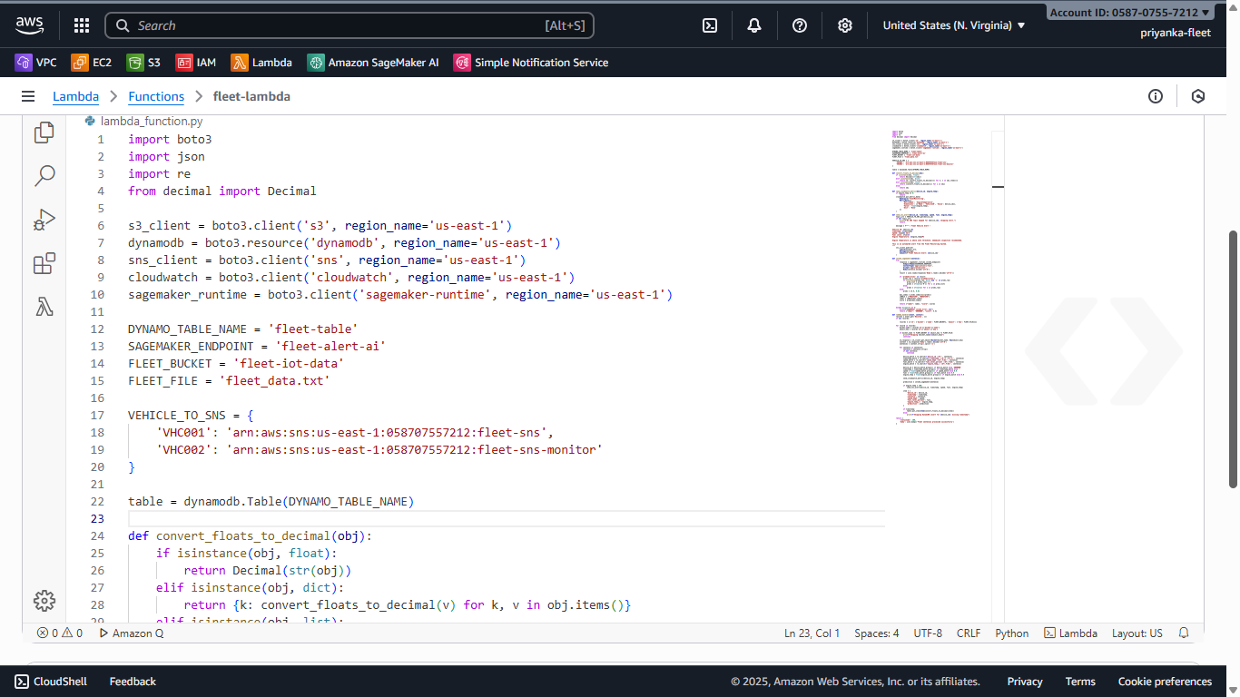
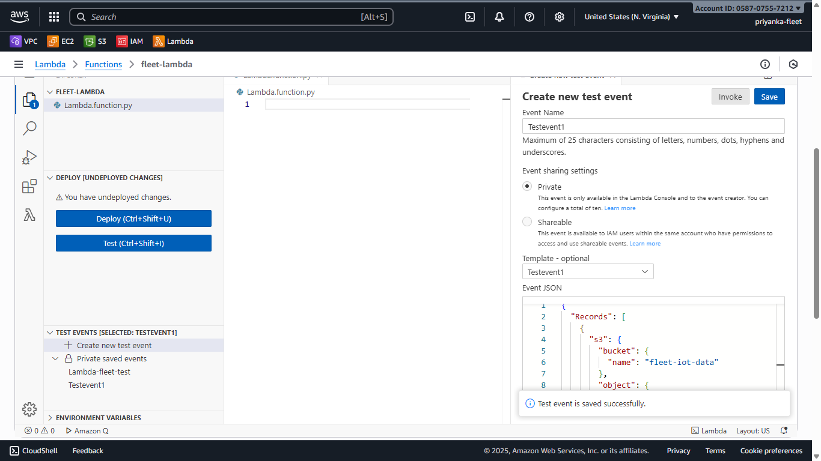
LAMBDA FUNCTION
Lambda orchestrates the complete workflow using python ,ingesting data from S3, sending alerts, invoking SageMaker for ML predictions, and storing results in DynamoDB .For full code - Github

Slide 16
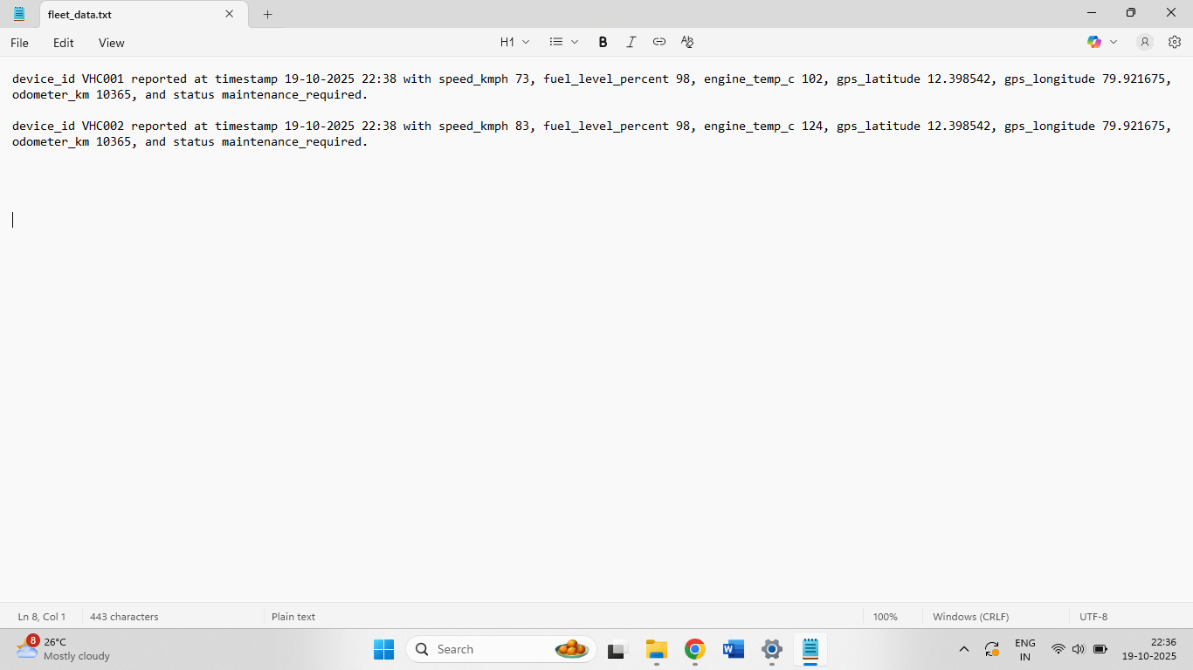
RAW DATA
Using 2 raw sentence datas for demo

Slide 17
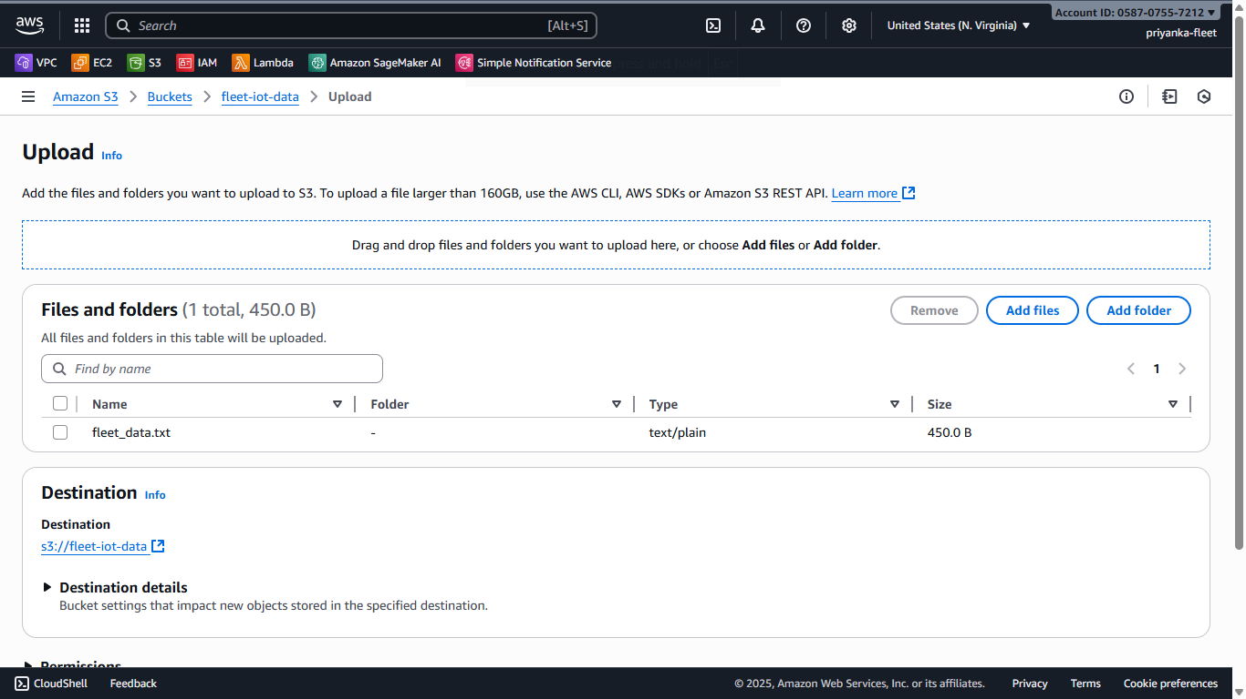
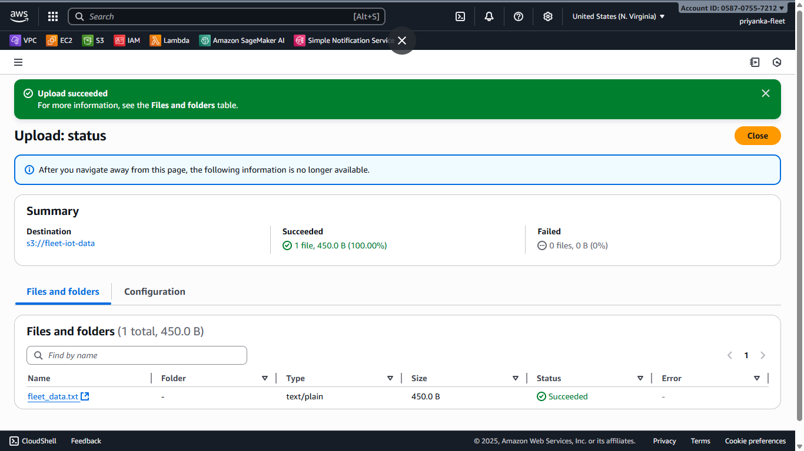
WORKING DEMO
Uploading the raw data file to s3 bucket

Slide 18
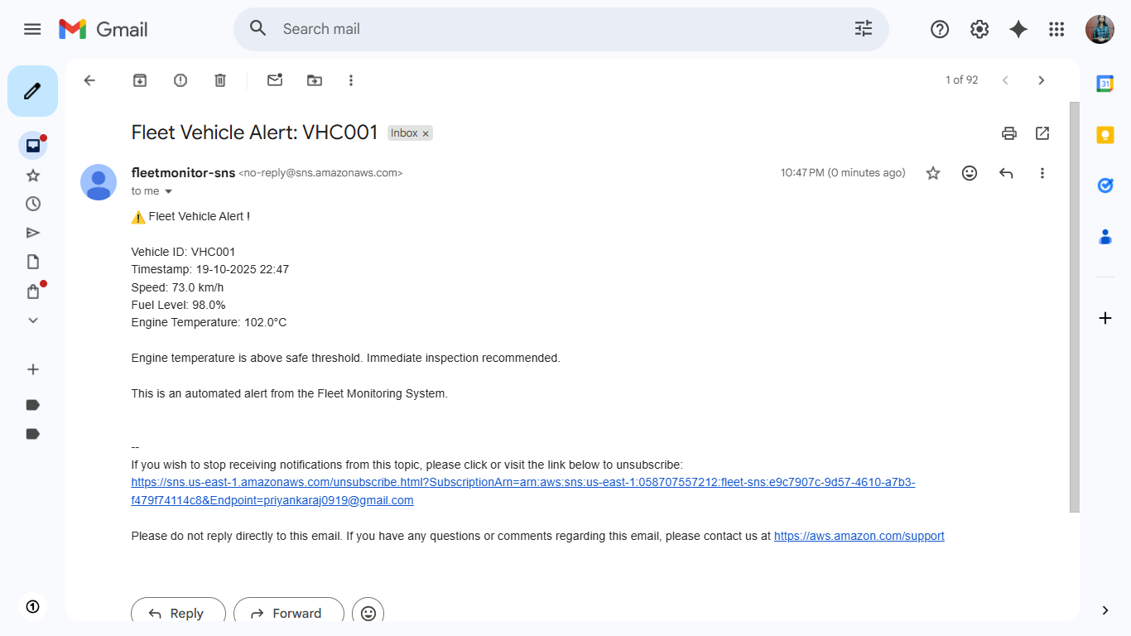

FLEET ALERT MAIL
Received the alert mail to the 1st Subscription mail id as the temperature is >100

Slide 19
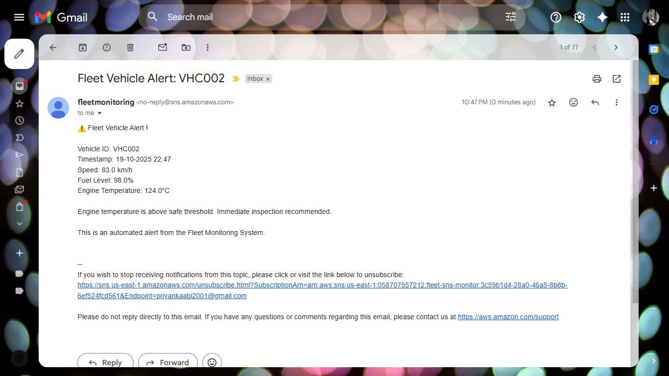
Received the alert mail to the 2st Subscription mail id added as the temperature is >100

Slide 20
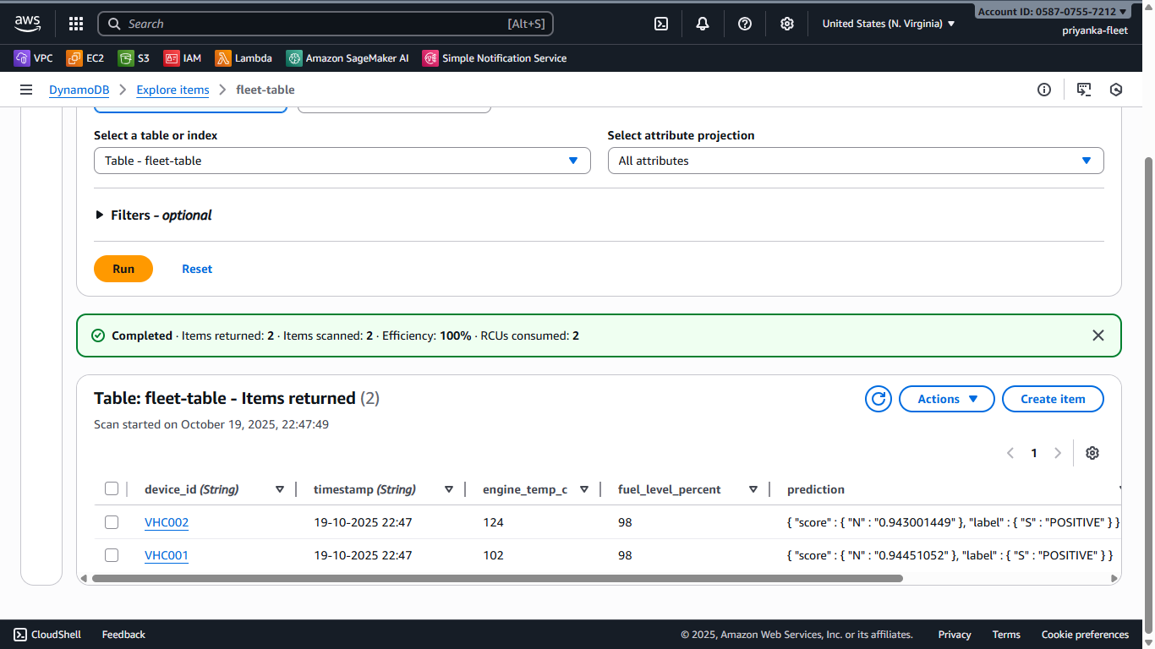
SAGEMAKER PREDICTION
After uploading raw files in S3,Dynamo DB makes it a clear organised file and Sagemaker checks on S3 and predicts “POSITIVE”.

Slide 21
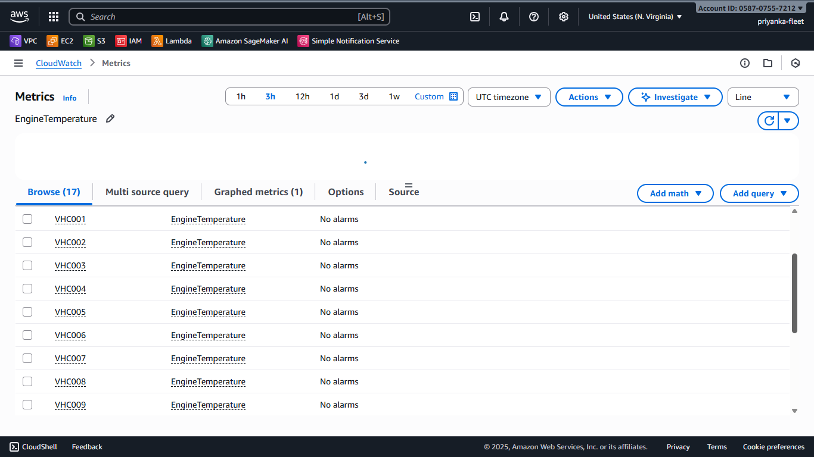
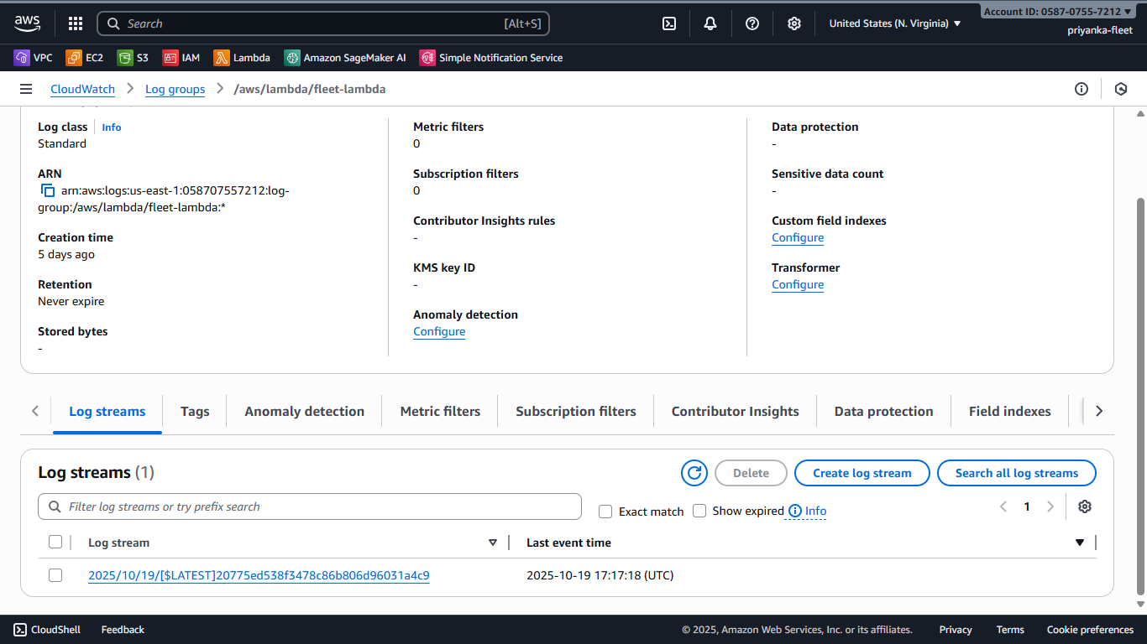
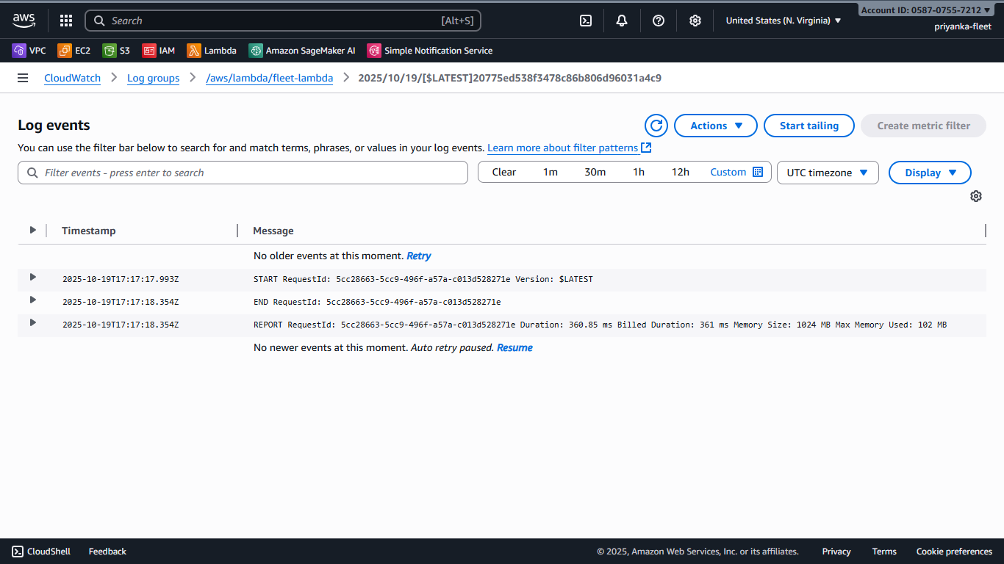
CLOUD WATCH LOGS
Cloud watch shows the metrics and logs of the events done recently

Slide 22
PROJECT SUMMARY
Designed and implemented an end-to-end fleet monitoring & predictive maintenance system using AWS.
Built an automated workflow across S3, Lambda, SageMaker, DynamoDB, and SNS.
Achieved real-time data processing, prediction, alerting, and secure storage.
Integrated IAM and KMS to ensure secure access and data protection.
The system is scalable, cost-effective, and suitable for large fleet operations.
Full code and detailed documentation are available in GitHub-Repository

Slide 23

THANK YOU
PRIYANKA RAJAGOPAL
priyankaraj0919@gmail.com

